Slide 1
COVID-19 Equity Data
Penn Medicine Center for Health Equity Advancement
Prepared by: Jaya Aysola MD, DTMH, MPH
Reflects Data from. 3/6/20-6/28/20

Slide 2
All Entities Except LGH

Slide 3
Philadelphia Hospitals

Slide 7
COVID-19 Admitted Cases

Slide 8
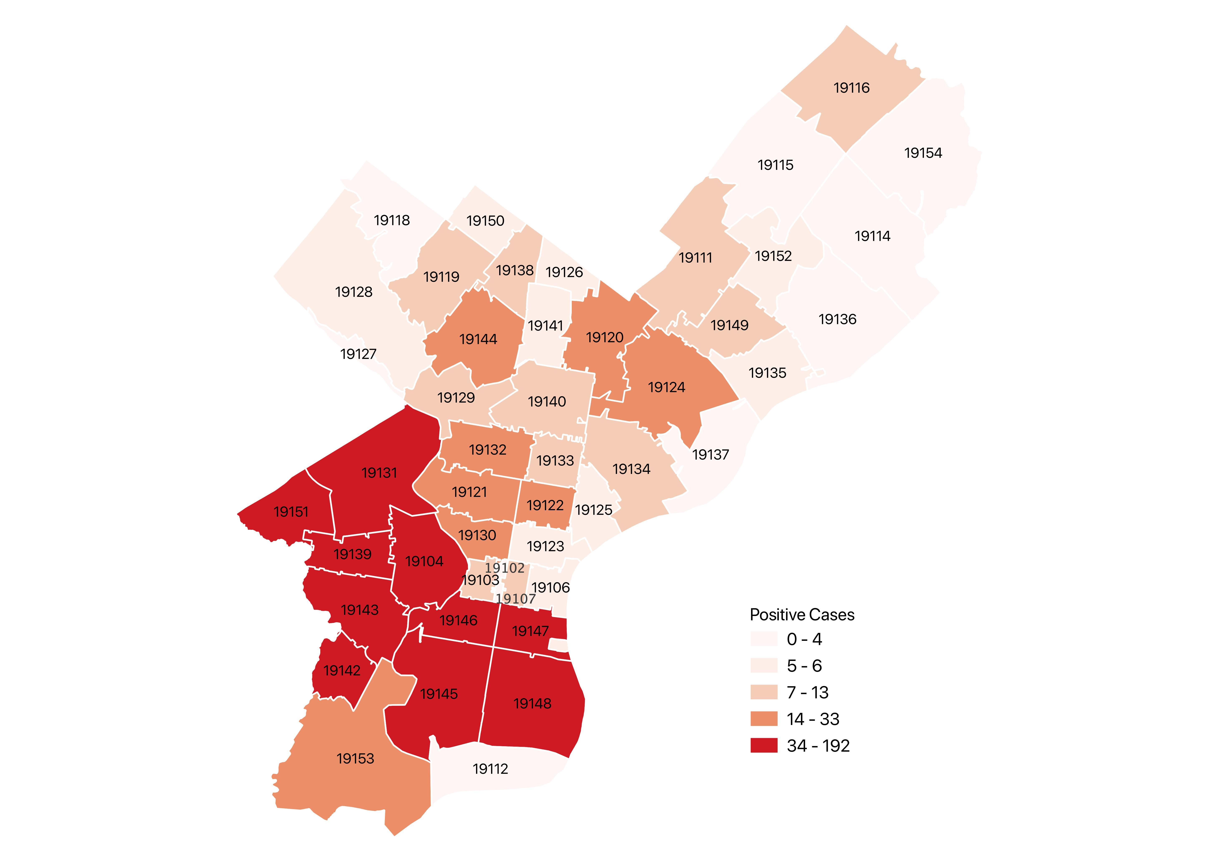
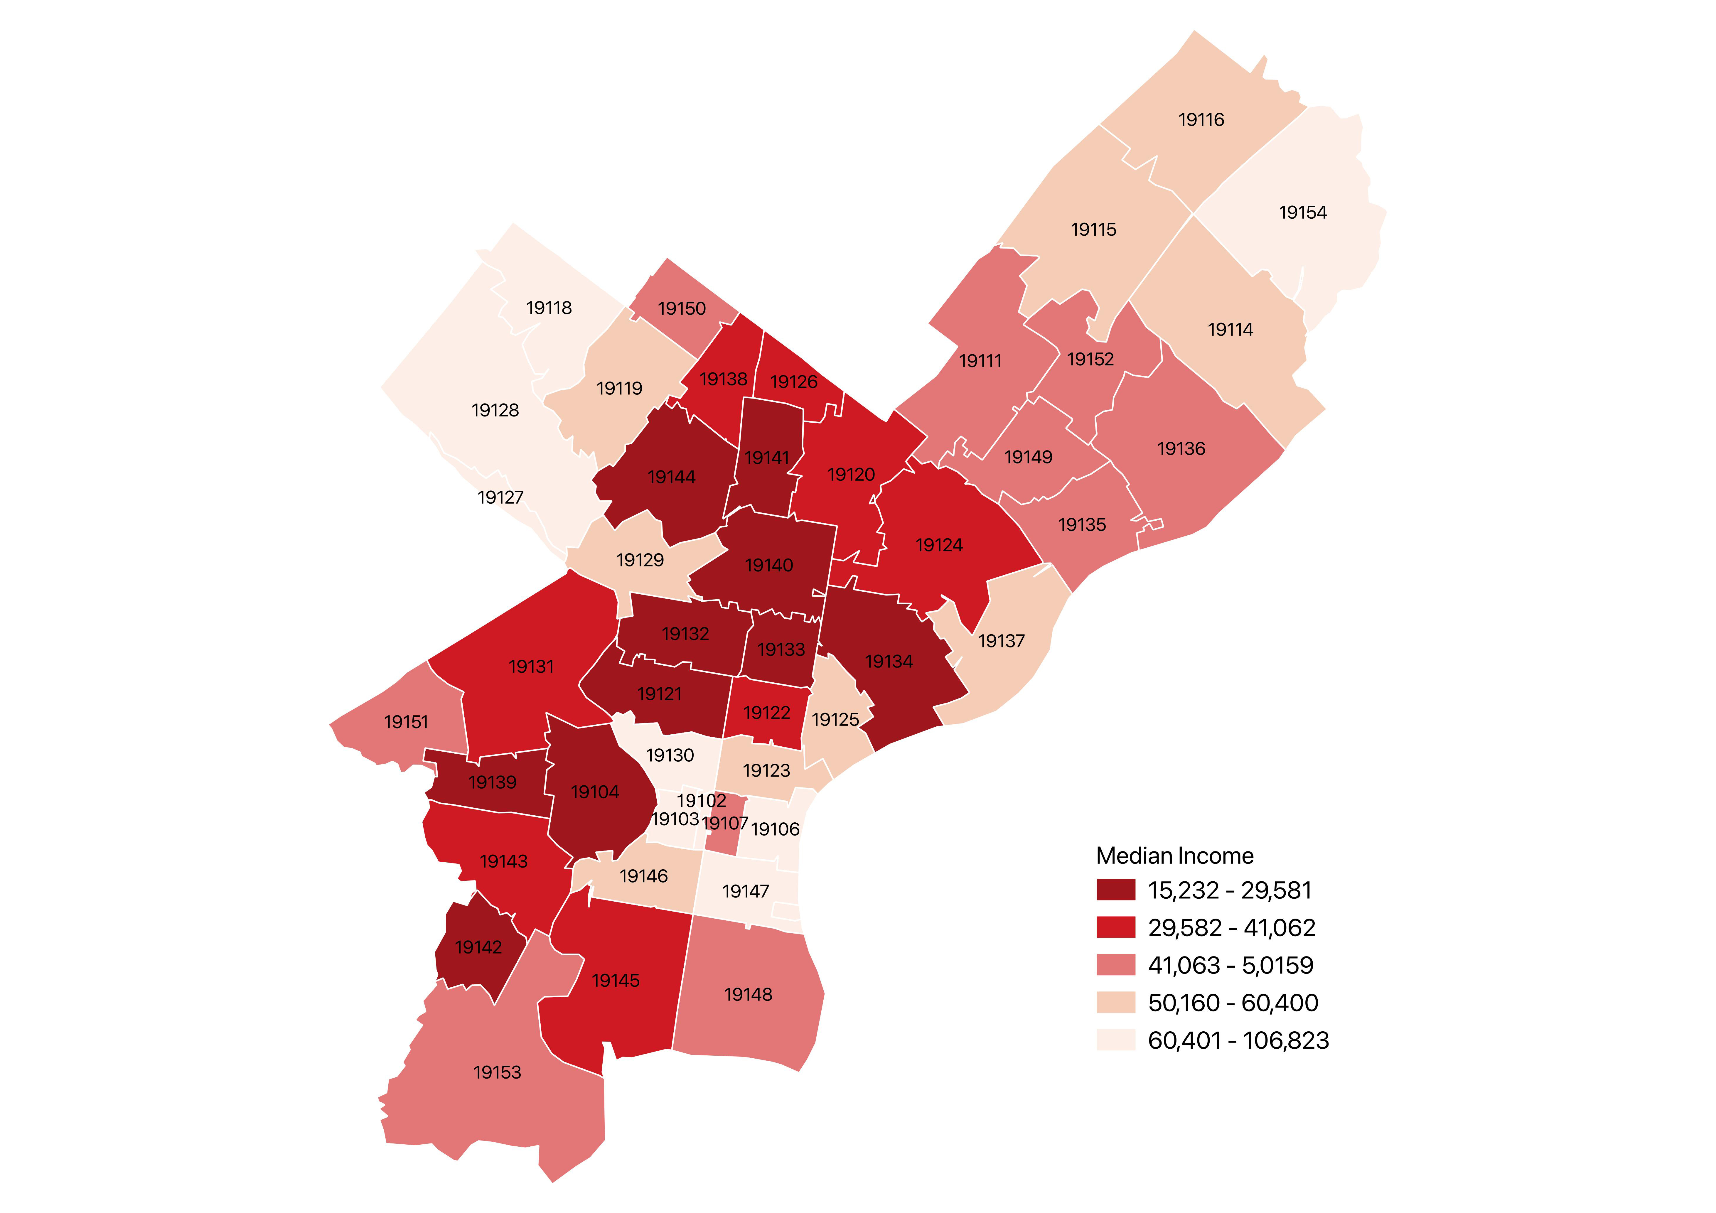
Penn Medicine Positive COVID-19 Cases by Zip Code
3/17/20-6/29/20
Median Household Income by Zip Code (ACS 2013 - 2017)

Slide 9
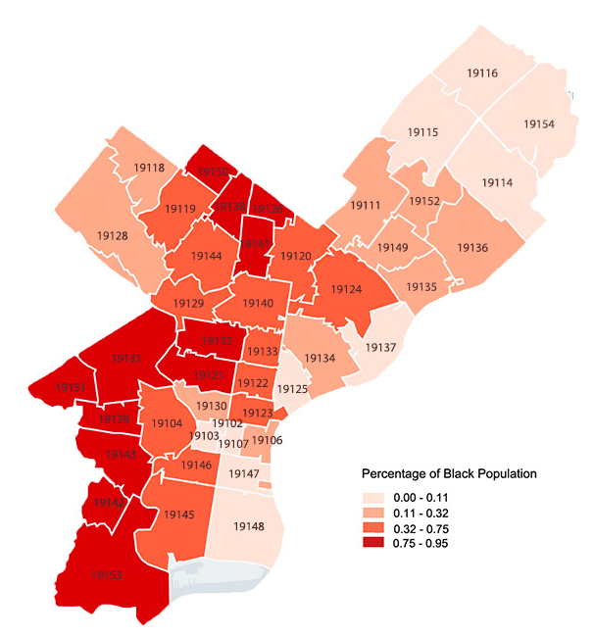
Penn Medicine Positive COVID-19 Cases by Zip Code
3/17/20-6/29/20
Percentage of Black Population
By Zip Code (ACS 2013 - 2017)

Slide 10
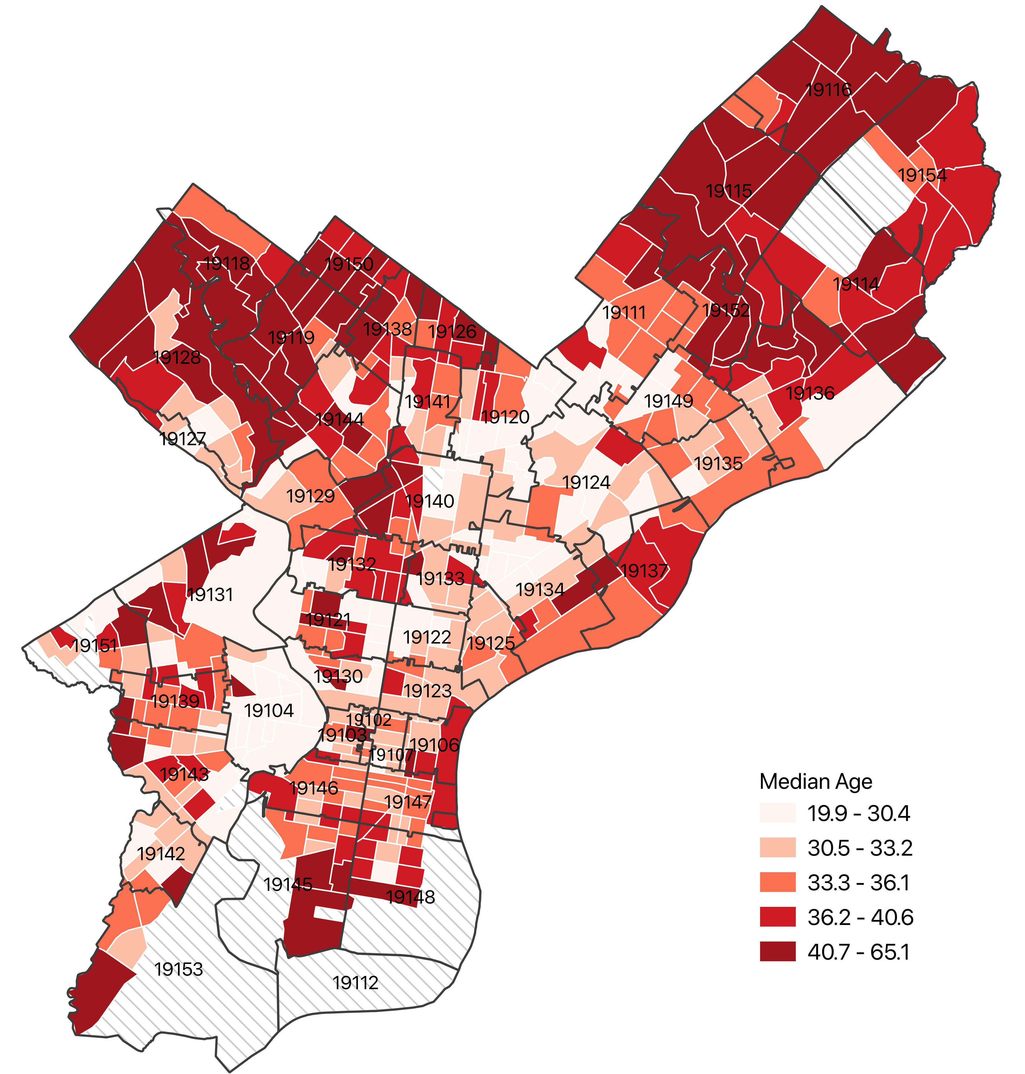
Penn Medicine Positive COVID-19 Cases by Zip Code
3/17/20-6/29/20
Median Age by Census Tract in Philadelphia
(ACS 2013 - 2017)

Slide 11
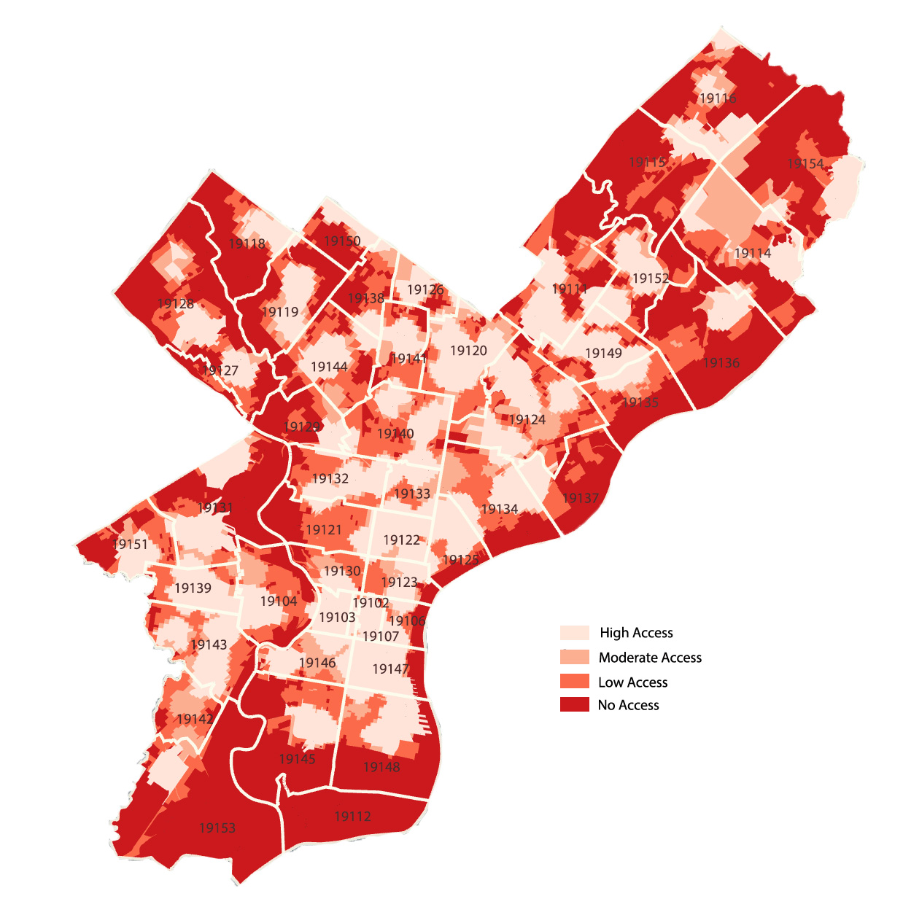
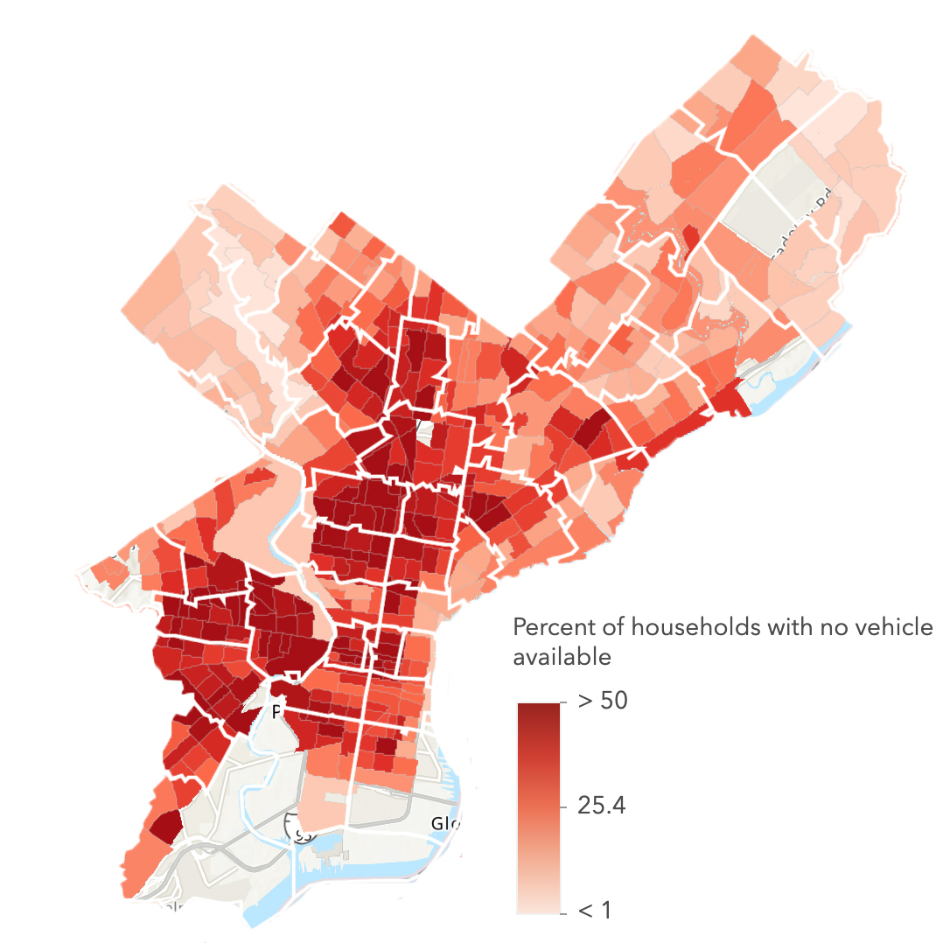
Penn Medicine Positive COVID-19 Cases by Zip Code
3/17/20-6/29/20
Walkable Access to Healthy Foods
in Philadelphia, 2012 - 2014
Vehicle Availability in Philadelphia
(ACS 2014 - 2018)

Slide 12
COVID-19 Mortality Rates* Unadjusted mortality rates of PPMC, PAH, HUP inpatients

Slide 13
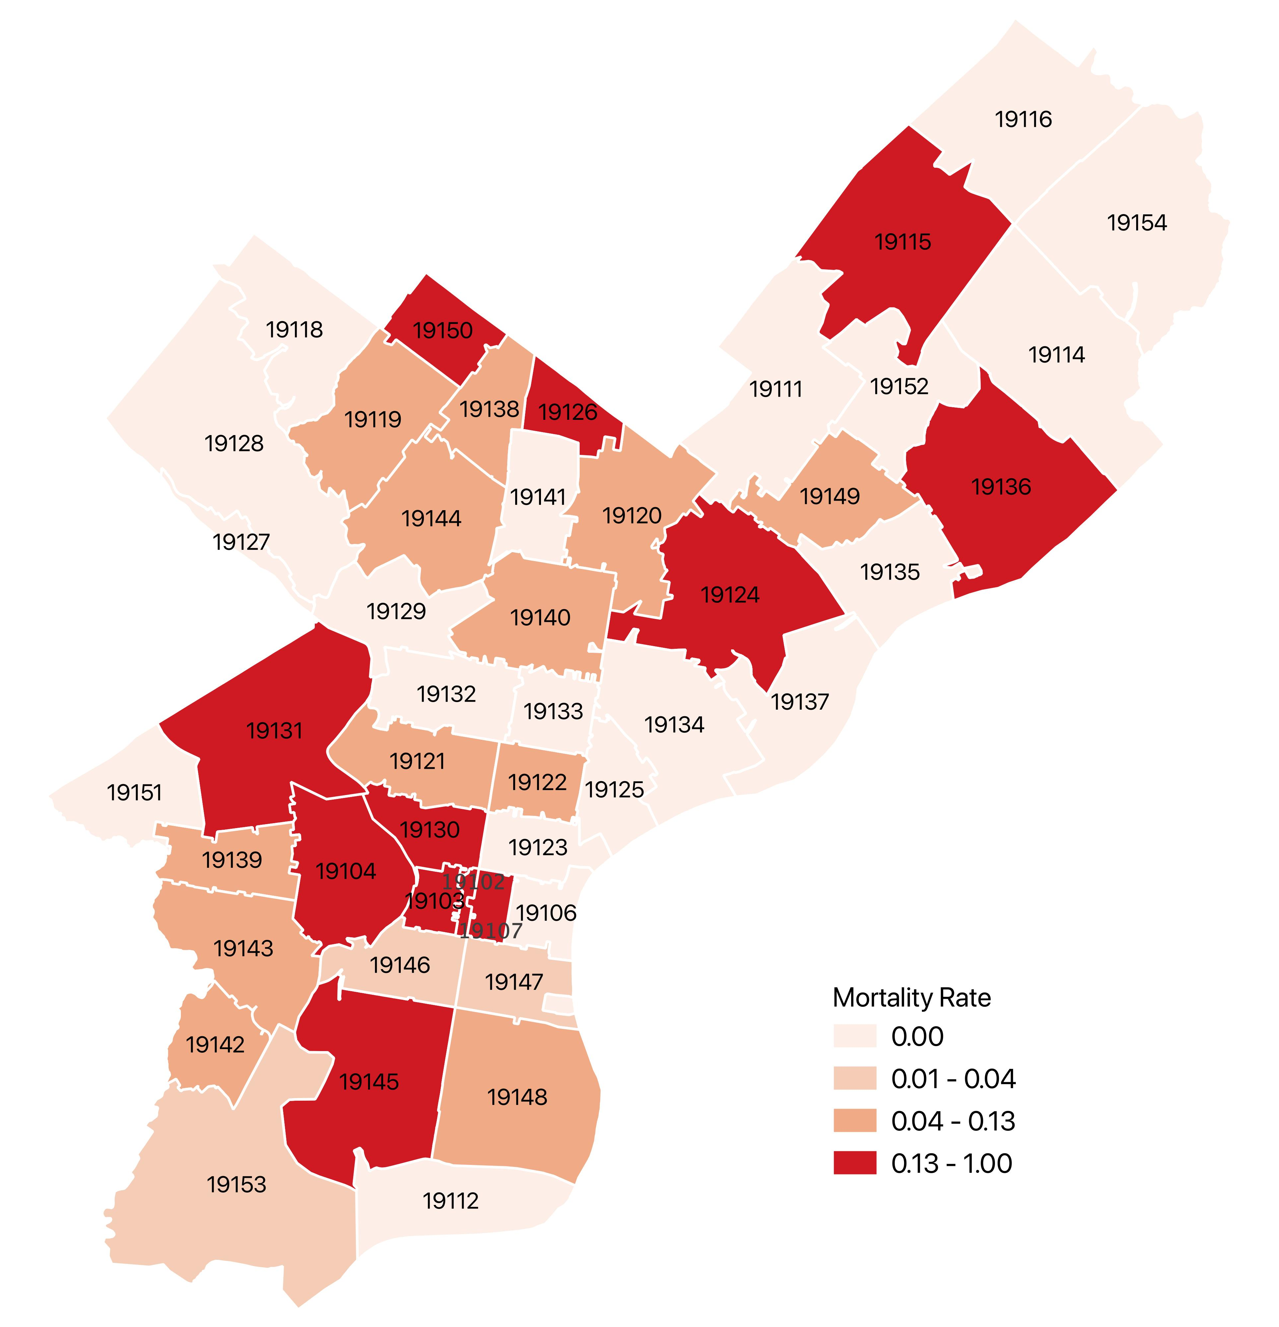
Walkable Access to Healthy Foods
in Philadelphia, 2012 - 2014
Vehicle Availability in Philadelphia
(ACS 2014 - 2018)
Penn Medicine Patients COVID-19 Mortality Rate by Zip Code. 3/17/20-6/29/20
Median Household Income by Zip Code (ACS 2013 - 2017)
Percentage of Black Population
By Zip Code (ACS 2013 - 2017)

Slide 14
Penn Medicine Patients COVID-19 Mortality Rate by Zip Code 3/17/20-6/29/20
Median Age by Census Tract in Philadelphia
(ACS 2013 - 2017)

Slide 15
Chester County Hospital Data

Slide 17
COVID-19 Admitted CCH Cases

Slide 18
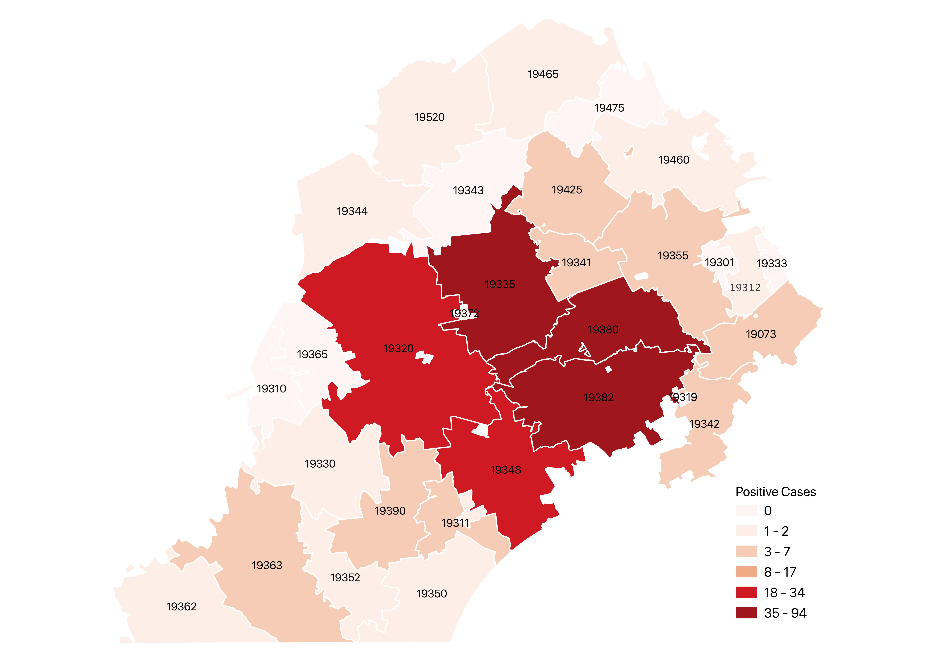
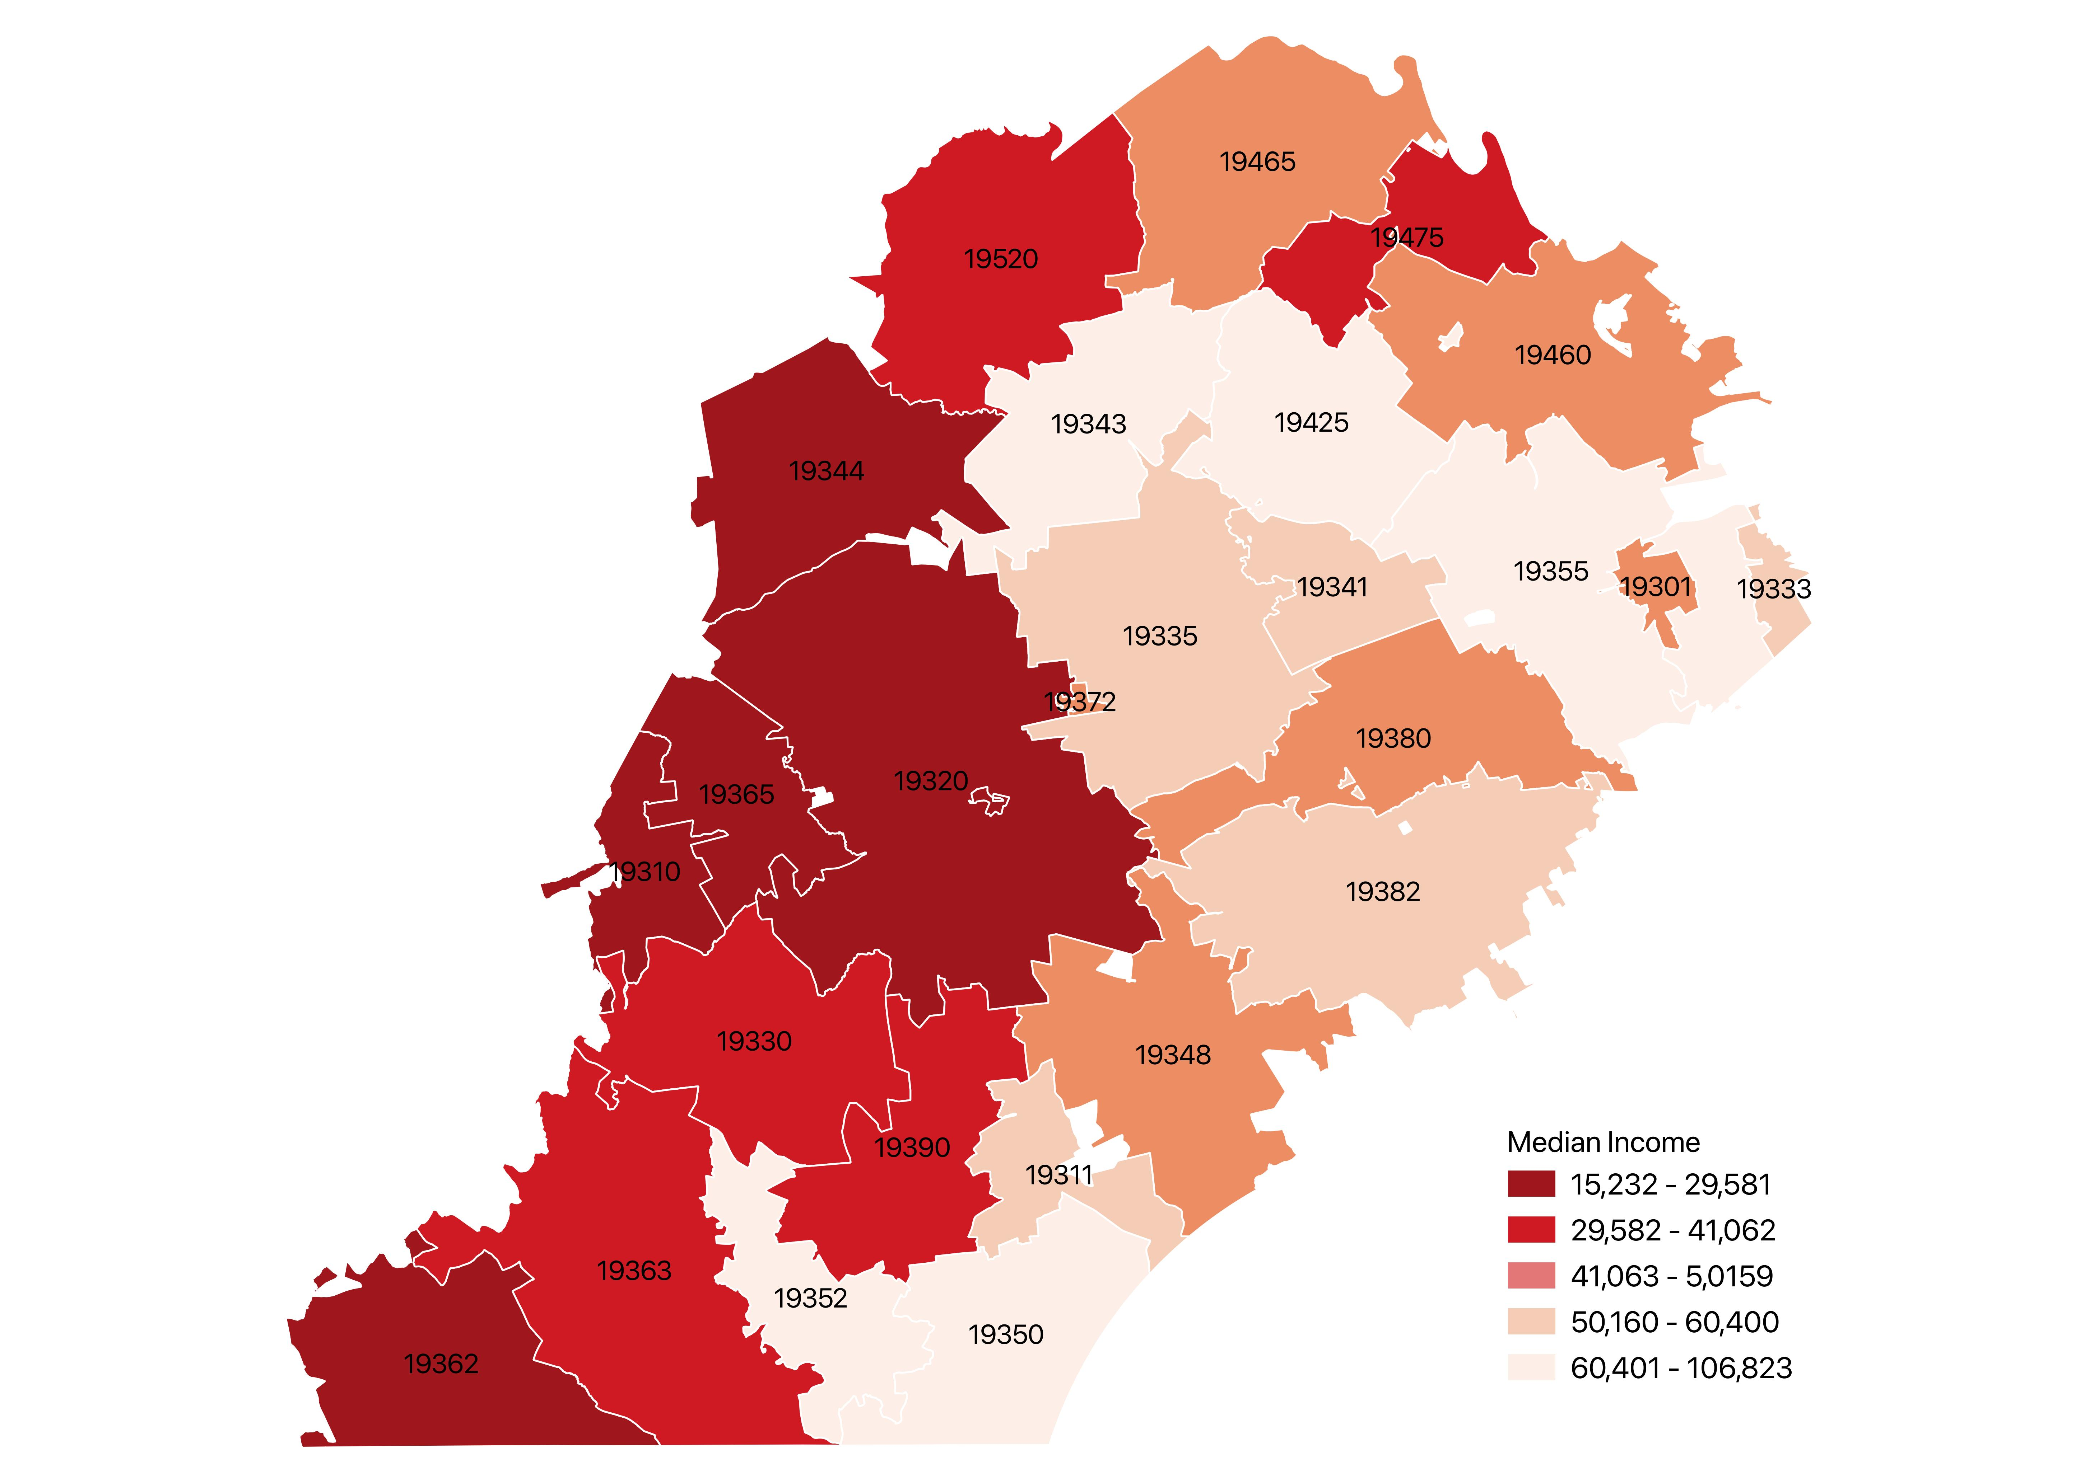
Penn Medicine Positive COVID-19 Cases
by Zip Code, Chester County 3/17/20-6/29/20
Median Household Income, Chester
County by Zip Code (ACS 2013 - 2017)

Slide 19
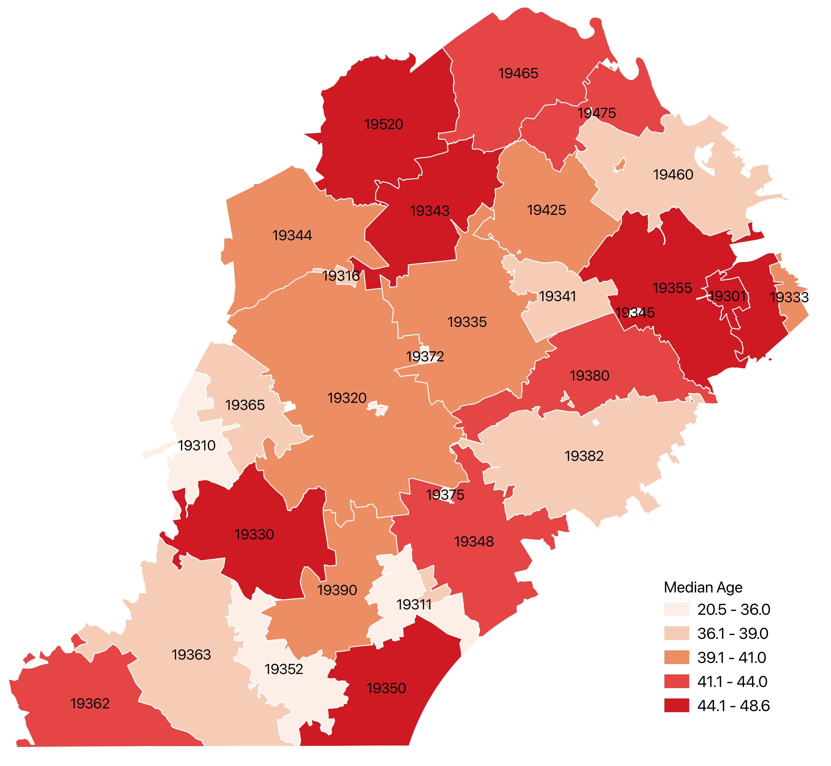
Penn Medicine Positive COVID-19 Cases by Zip Code, Chester County 3/17/20-6/29/20
Median Age in Chester County
By Zip Code (ACS 2013 - 2017)

Slide 20
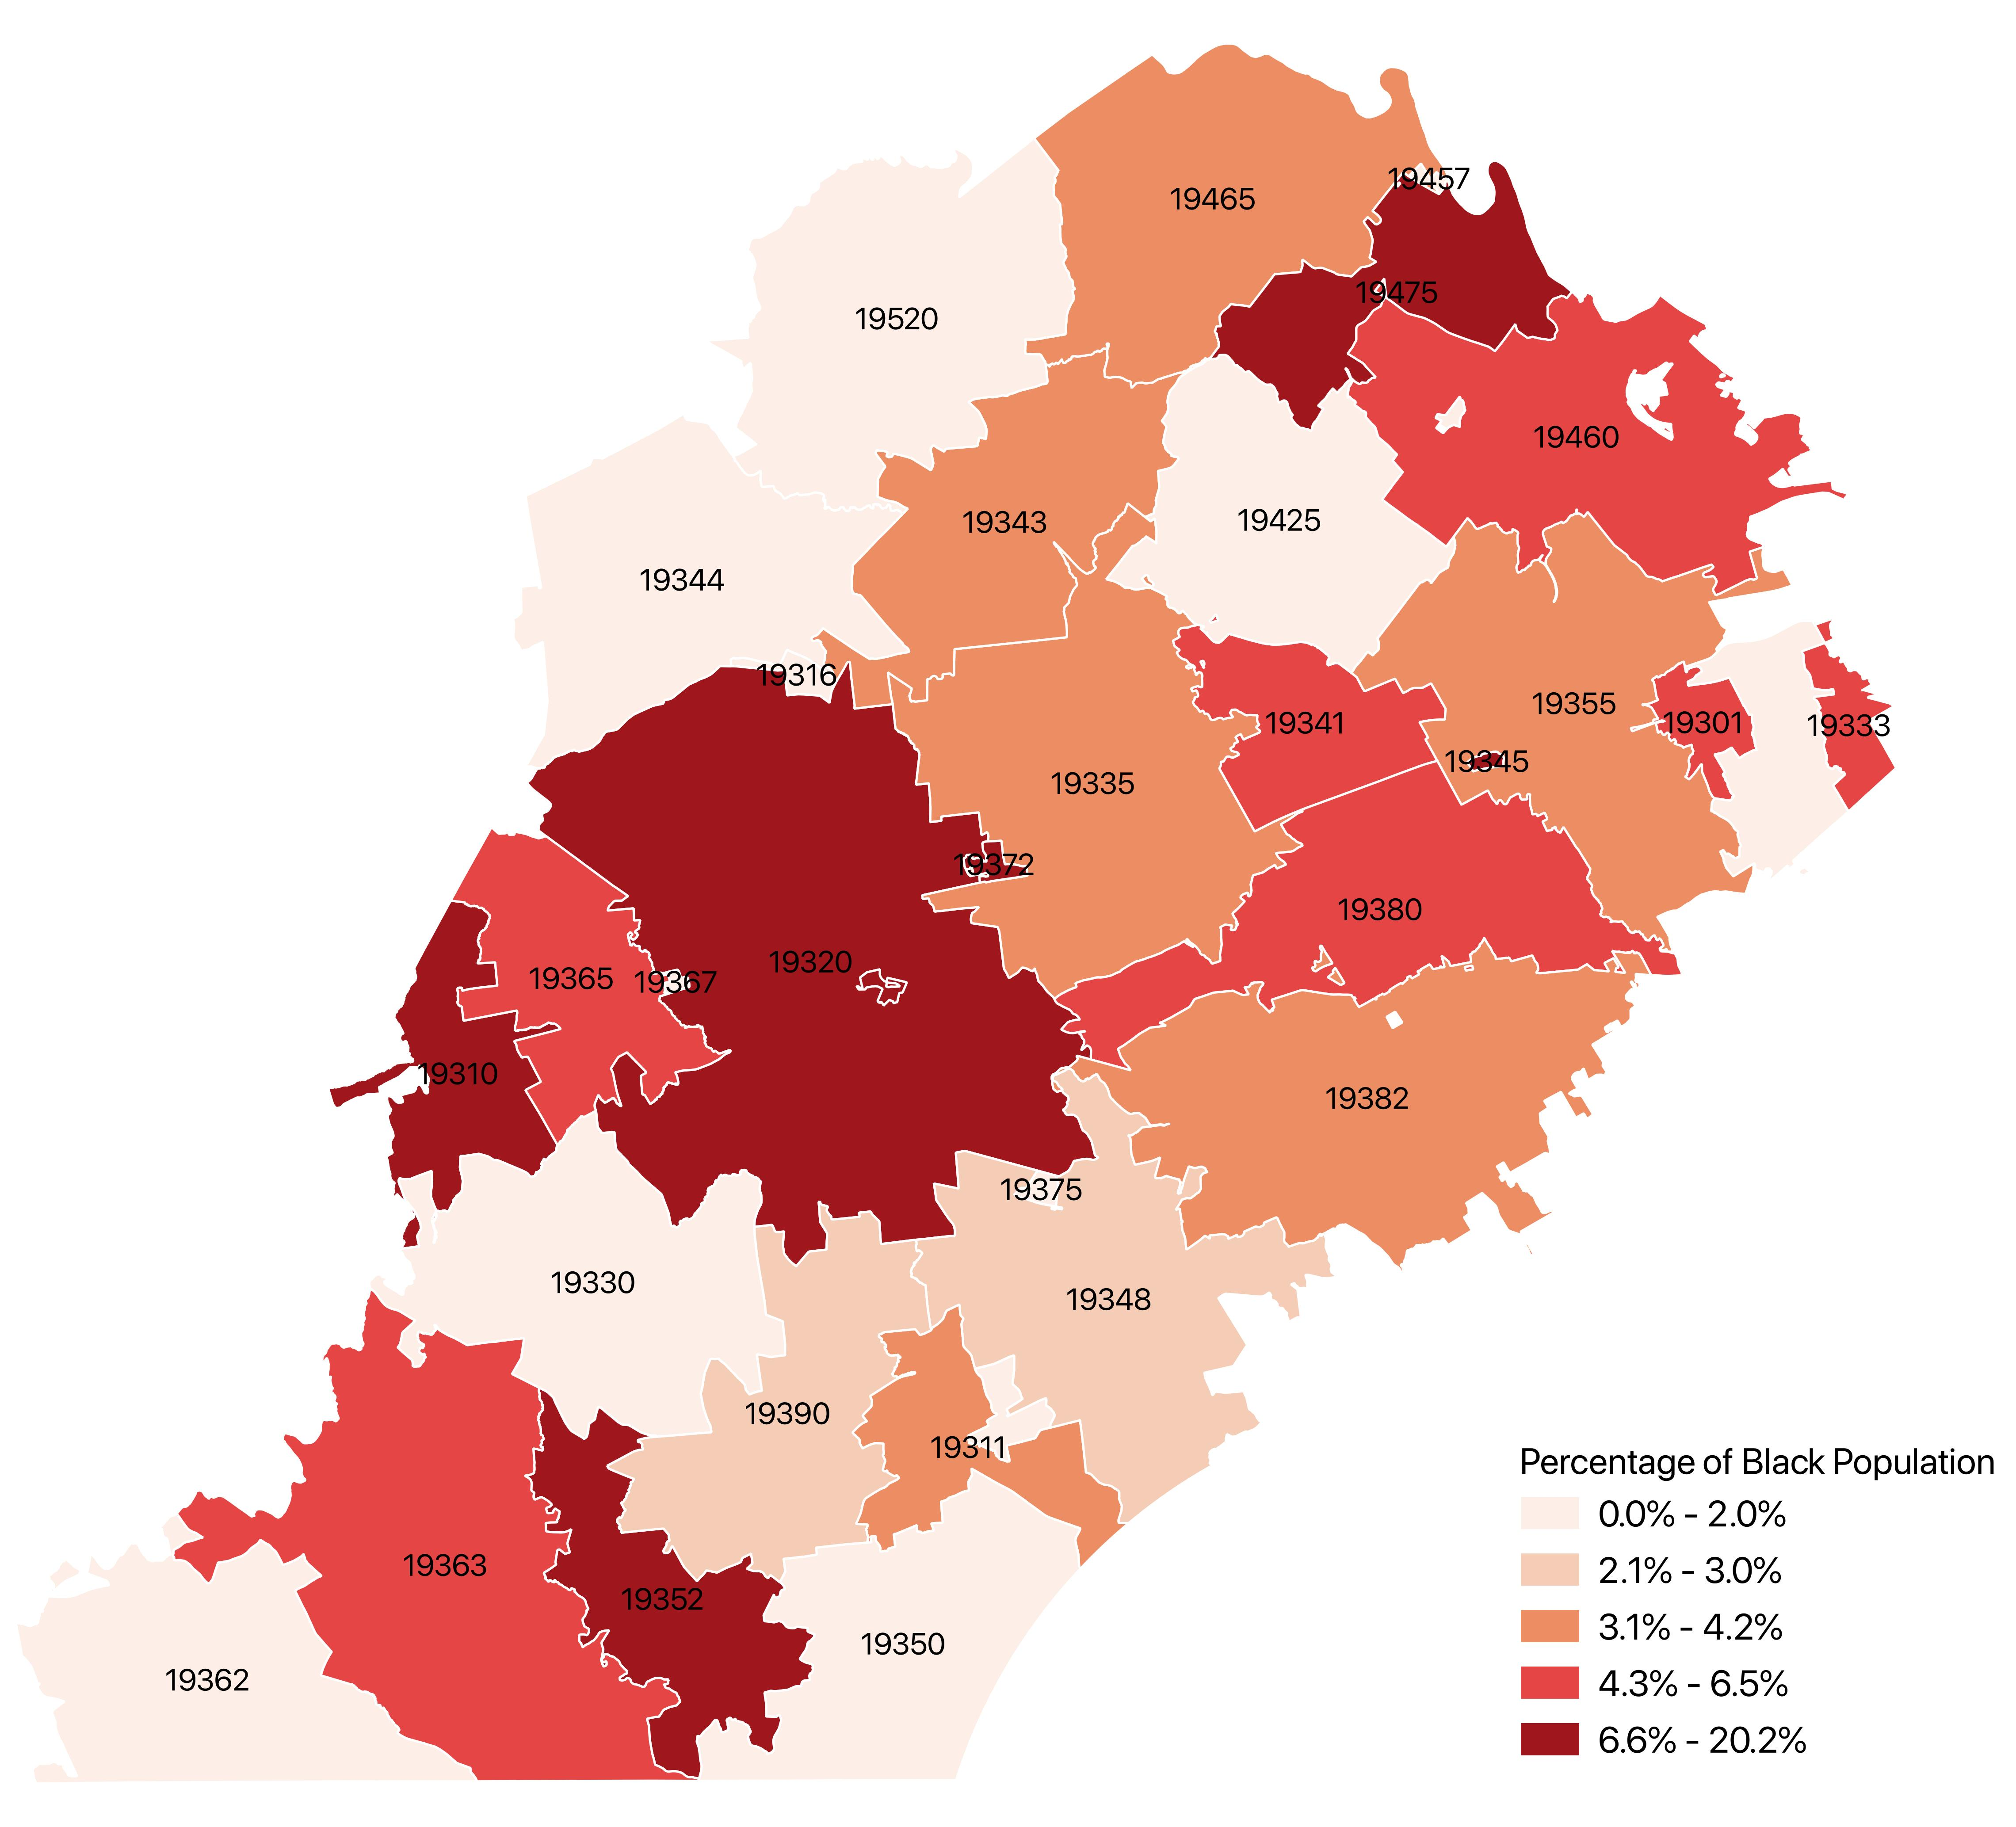
Penn Medicine Positive COVID-19 Cases by Zip Code, Chester County 3/17/20-6/29/20
Percentage of Black Population,
Chester County By Zip Code
(ACS 2013 - 2017)

Slide 21
COVID-19 CCH Mortality Rates* Unadjusted mortality rates of CCH inpatients

Slide 22
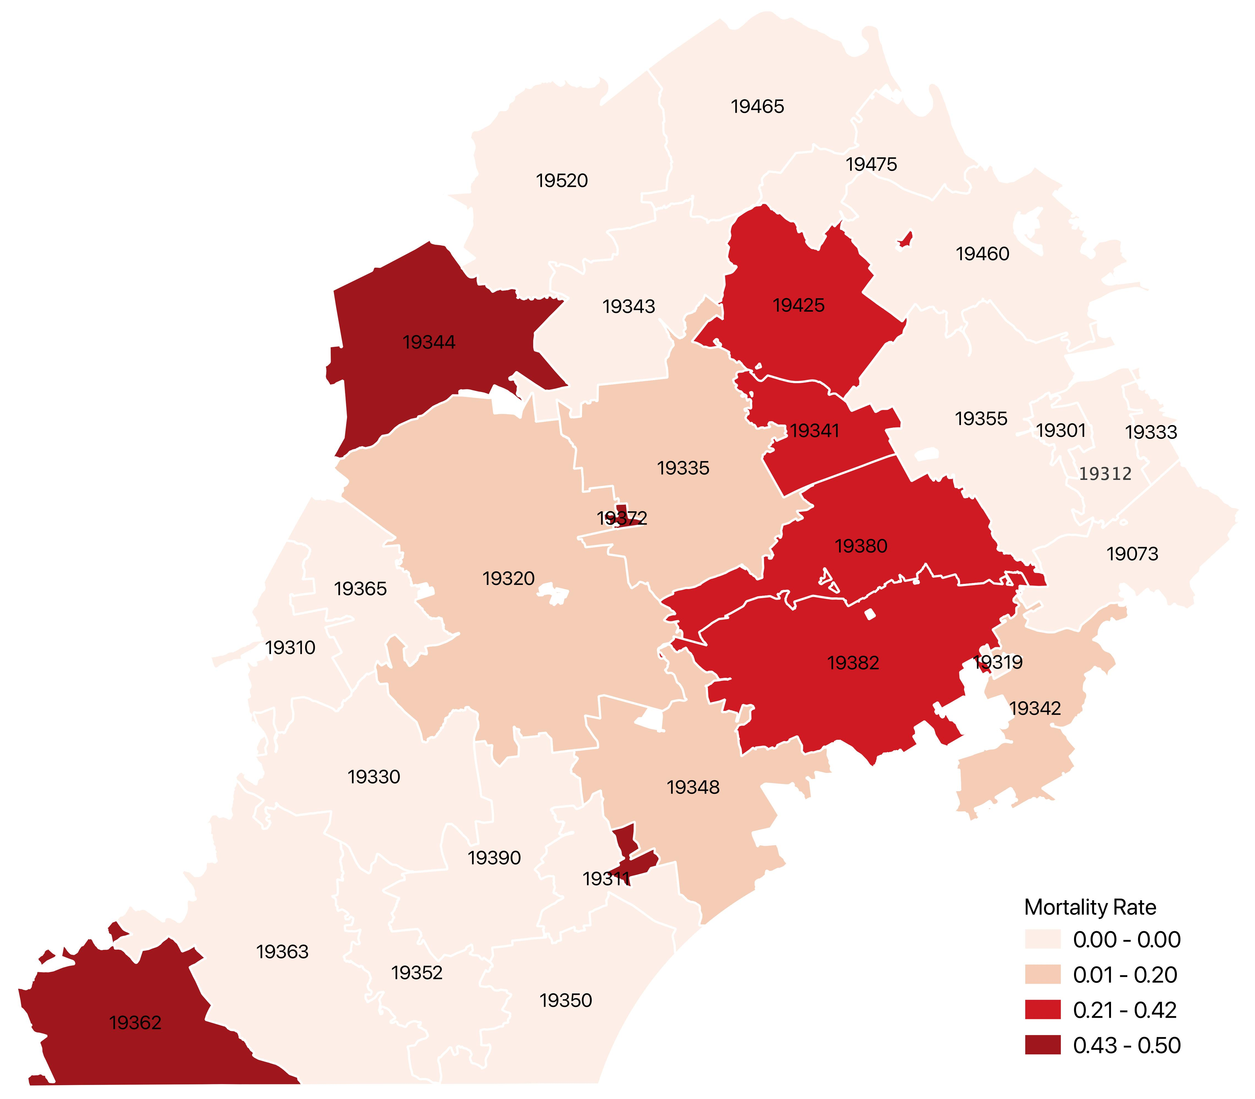
Penn Medicine Patients COVID-19 Mortality Rate Chester County by Zip Code. 3/17/20-6/29/20
Median Age in Chester County
By Zip Code (ACS 2013 - 2017)

Slide 23
Penn Medicine Patients COVID-19 Mortality Rate Chester County by Zip Code. 3/17/20-6/29/20
Percentage of Black Population,
Chester County By Zip Code
(ACS 2013 - 2017)

Slide 24
Penn Medicine Patients COVID-19 Mortality Rate Chester County by Zip Code. 3/17/20-6/29/20
Median Household Income, Chester
County by Zip Code (ACS 2013 - 2017)

Slide 25
Princeton Hospital Data * No spatial analysis was conducted as patients came from only 2 zip codes

Slide 27
Questions: jaysola@upenn.edu

Slide 29
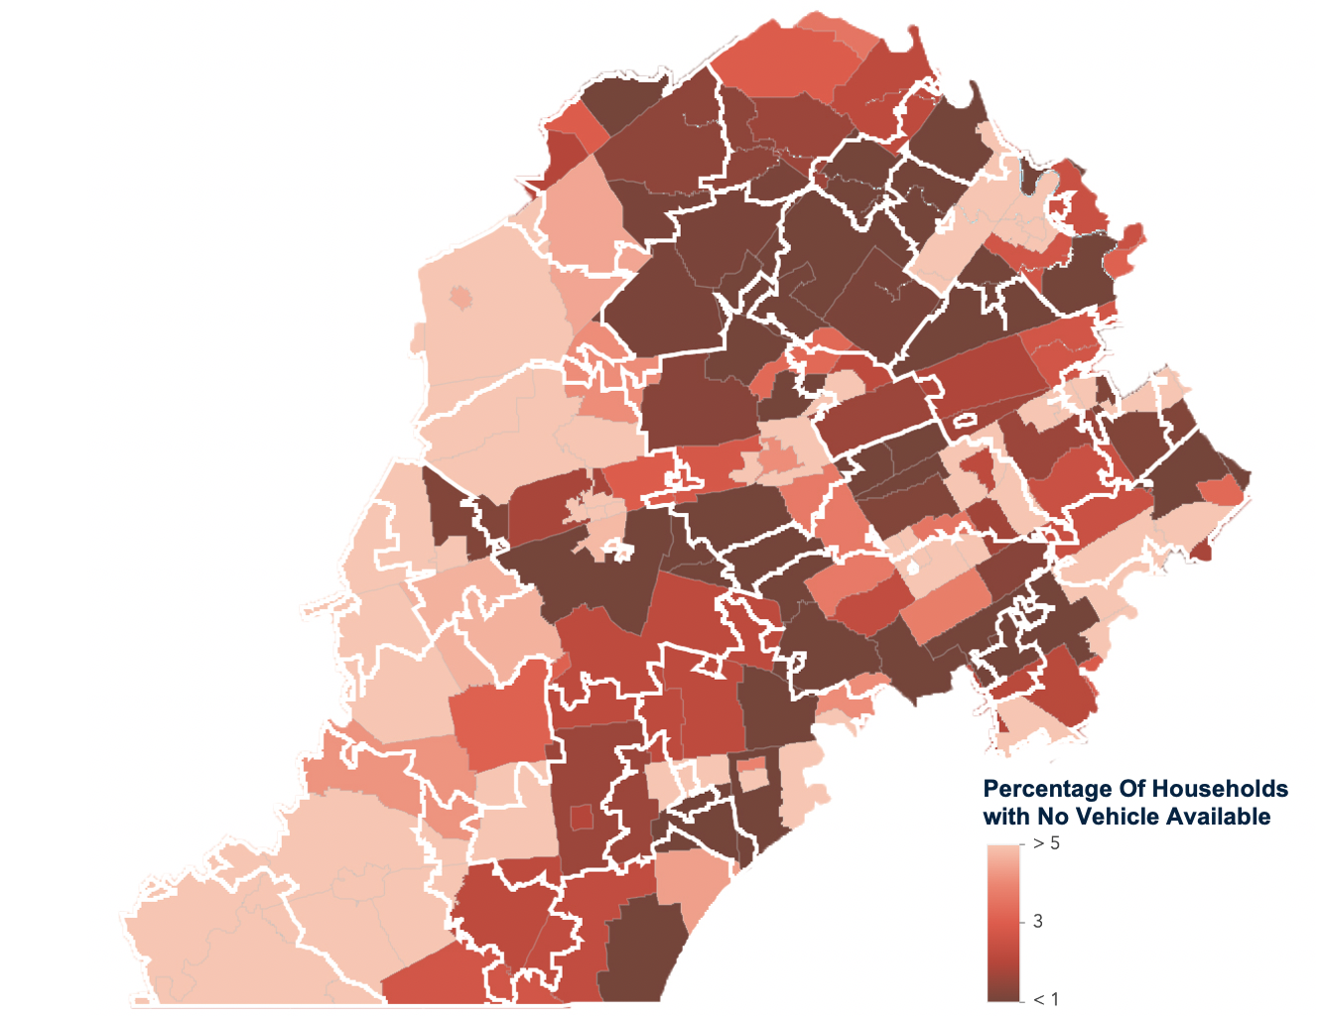
Vehicle Availability in Chester County
(ACS 2014 - 2018)

